Slide 1


Slide 2
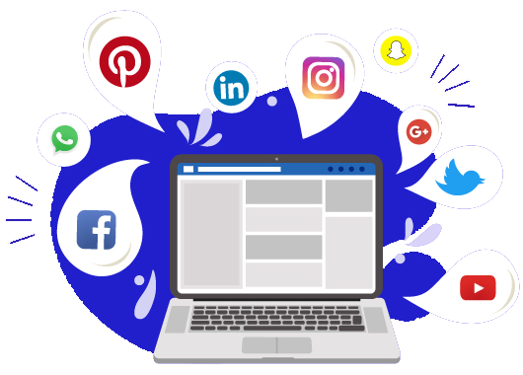
Paid Social Media Advertising

Slide 3
Paid social media advertising involves using paid ads on social platforms to reach a wider audience and promote products or services
What is Paid Social Media Advertising?
Definition
Purpose
Increase brand awareness
Drive traffic
Generate leads or sales

Slide 4
Benefits of Facebook and Instagram Advertising
Wide Audience Reach
Access to billions of users globally on both platforms
Targeting Capabilities
Advanced targeting based on demographics, interests, behaviors, and custom audiences
Cost-Effective
Flexible budgeting options allow for controlled costs based on performance
Performance Tracking
Comprehensive analytics to measure ad effectiveness and ROI

Slide 5
Types of Ads on Facebook & Instagram
Image Ads
Simple yet effective ads featuring a single image
Video Ads
Engaging video content to capture audience attention
Carousel Ads
Multiple images or videos in a single ad that users can swipe through
Stories Ads
Full-screen ads that appear in users' stories on both platforms
Collection Ads
Showcase multiple products for an immersive shopping experience

Slide 6
Setting Up a Facebook Ad Campaign
Step 1
Create a Facebook Business Manager Account
Central hub for managing ad accounts, pages, and team
Step 2
Define Your Campaign Objective
Choose from objectives like brand awareness, traffic, engagement, or conversions
Step 3
Set Your Target Audience
Use demographic and behavioral targeting options
Step 4
Budget and Schedule
Determine daily or lifetime budget and ad schedule
Step 5
Create Your Ad
Design the ad using visuals, copy, and a clear CTA

Slide 7
Setting Up an Instagram Ad Campaign
Integration with Facebook Ads
Instagram ads are managed through Facebook Business Manager
Select Instagram Placement
Choose between Instagram feed, stories, or both
Creative Considerations
Use visually appealing content tailored to Instagram’s aesthetic
Utilize Instagram Shopping
Tag products directly in posts and stories to drive sales

Slide 8
Simple Ad Targeting Techniques
Custom Audiences
Target users who have interacted with your business (e.g., website visitors, email subscribers)
Lookalike Audiences
Reach new users similar to your best existing customers
Interest-Based Targeting
Target users based on their interests, behaviors, and activities on the platform

Slide 9
Key Metrics for Measuring Ad Performance
Impressions
Total times your ad was shown
Clicks
Number of times users clicked on your ad
Click-Through Rate (CTR)
Percentage of people who clicked on your ad after seeing it
Conversions
Actions taken as a result of the ad (e.g., purchases, sign-ups)
Return on Ad Spend (ROAS)
Revenue generated for every dollar spent on ads

Slide 10
Best Practices for Facebook and Instagram Ads
Test and Optimize
A/B test different creatives, audiences, and placements to find what works best
Clear Call to Action (CTA)
Encourage users to take specific actions (e.g., "Shop Now," "Sign Up")
Use High-Quality Visuals
Invest in quality images and videos to enhance engagement
Engage with Comments
Respond to comments on ads to build community and trust

Slide 11
Discussion Questions
What types of ads have you found most engaging on Facebook or Instagram? Why?
(Encourage reflection on the types of ads that caught their attention)
Do you have any experience running ads on these platforms? What challenges did you face?
(Encourage students to share their experiences and discuss challenges)

Slide 12
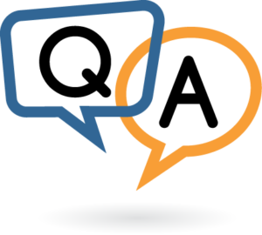

Slide 13


